Slide 1



"Serious" B2B Marketing Sup port Starting with Webinars Introduction to Majisemi
For Those Considering Majisemi for the First Time
Seminars Strong in Attracting Customers
No.1
Seminars Strong in Acquiring New Business Negotiations
No.1
Seminars Chosen by IT Managers
No.1
Survey by Japan Marketing Research Organization Overview: 2021 Service Comparison Impression Survey

Slide 2
Introduction
本日の打ち合わせの目的
はじめて「マジセミ」をご検討される企業のために、以下のような内容についてお話させていただきます。
マーケティングにおける課題のヒアリング
どのようにマジセミをご活用いただくのか？
©2018 MAJISEMI Inc.

Slide 3
ヒアリング
©2018 MAJISEMI Inc.

Slide 4
ヒアリング
Issue Identification
■ About the products you want to introduce in the seminar
・Which product or service?
・Intended target audience (who you want to invite to the seminar)?
・Industry, company size, department, position, etc.
※ Majisemi's areas of expertise are "IT departments, DX departments, security departments across all industries, and production/manufacturing departments in factories"
・What are the competing products?
・What are the strengths and differentiation points compared to competing products?
©2018 MAJISEMI Inc.

Slide 5
ヒアリング
Issue Identification
■ On the Necessity of Seminars (Webinars)
・What is prioritized as a means of lead acquisition?
・Seminars (Webinars)
・Websites (Content Marketing)
・リアル展示会
・比較サイト
・GoogleやFacebookなどへの広告
・テレアポ
・その他
■予算の状況
・リード獲得単価、アポ獲得単価
・セミナー（ウェビナー）の予算の有無、及び金額
・上記リード獲得手段の予算の割合
・予算の策定、決定時期
©2018 MAJISEMI Inc.

Slide 6
ヒアリング
Issue Identification
■セミナー（ウェビナー）の目的／課題
・より多くのリードを獲得したい／集客できない
・ターゲットに合ったリードを獲得したい／リードの質が悪い
・ウェビナーから商談につなげたい／商談につながらない
・ウェビナーの運営を代行してほしい／運営が大変
・まずはスモールスタートでウェビナーをやってみたい
・その他
・ウェビナーを活用した、東南アジアにおける新規顧客開拓やテストマーケティング
©2018 MAJISEMI Inc.

Slide 7
なぜ「ウェビナー」なのか？
©2018 MAJISEMI Inc.

Slide 8
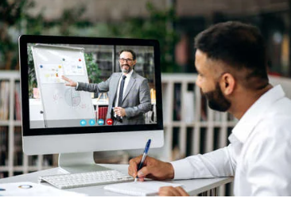

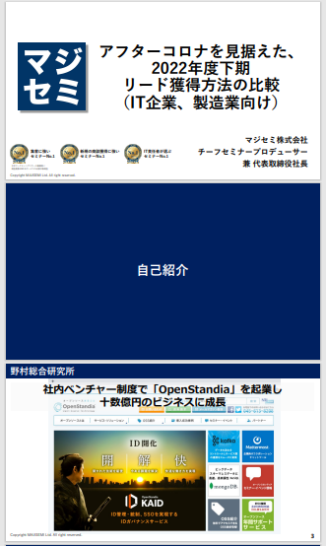
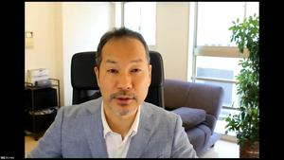
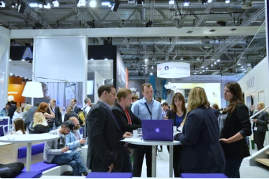
BtoBマーケティングにおけるウェビナーの役割
Webinar
as a Service
Lead acquisition
Lead Nurturing
Proposal & Order
課題に
気づいてない
課題に気づき
社内で検討
製品・サービスの
候補を捜す
製品・サービスを絞って
評価・選定、稟議
課題に気づかせる
課題について深く理解させ、
解決方法を提示する
競合よりもお客様に早く接触し、課題解決をサポートする
数社～十数者程度の検討の候補に入り、２～３社の最終候補に残る
２～３社の最終候補から自社を選んでもらう
Utilization of Webinar Content
課題に気づかせる。
課題について深く理解させる。
競合よりもお客様に先に接触し、自社を知ってもらう。
When holding a webinar,
a lot of content is generated.
● Presentation materials → White Paper
● Presentation video → YouTube, Social Media
● Presentation content → SEO articles, Blog
Webinar
Field Sales
Webサイト
Content Marketing
Webinar
Social Media Advertising
Deepen understanding of challenges.
Also provide competitive comparison information and information about our products.
For nurturing existing leads.
リアル展示会
オンラインイベント
Downloadable Materials
Field Sales
©2018 MAJISEMI Inc.

Slide 9

Email Advertising
Positioning of Webinars in Lead Acquisition
planning
Cost per Lead
Telemarketing
30,000 yen
Webinar
リアル展示会
Listing/Social Media Advertising
Visitor
14,500 yen
Majisemi
Club
10,000 yen and up
10,000 yen
Online
Exhibition
(Large-scale Webinar)
Comparison Site
Downloadable Materials
On-Demand
Video Distribution
5,000 yen
リアル展示会
Joint exhibition
Low
Interest
High
©2018 MAJISEMI Inc.

Slide 10
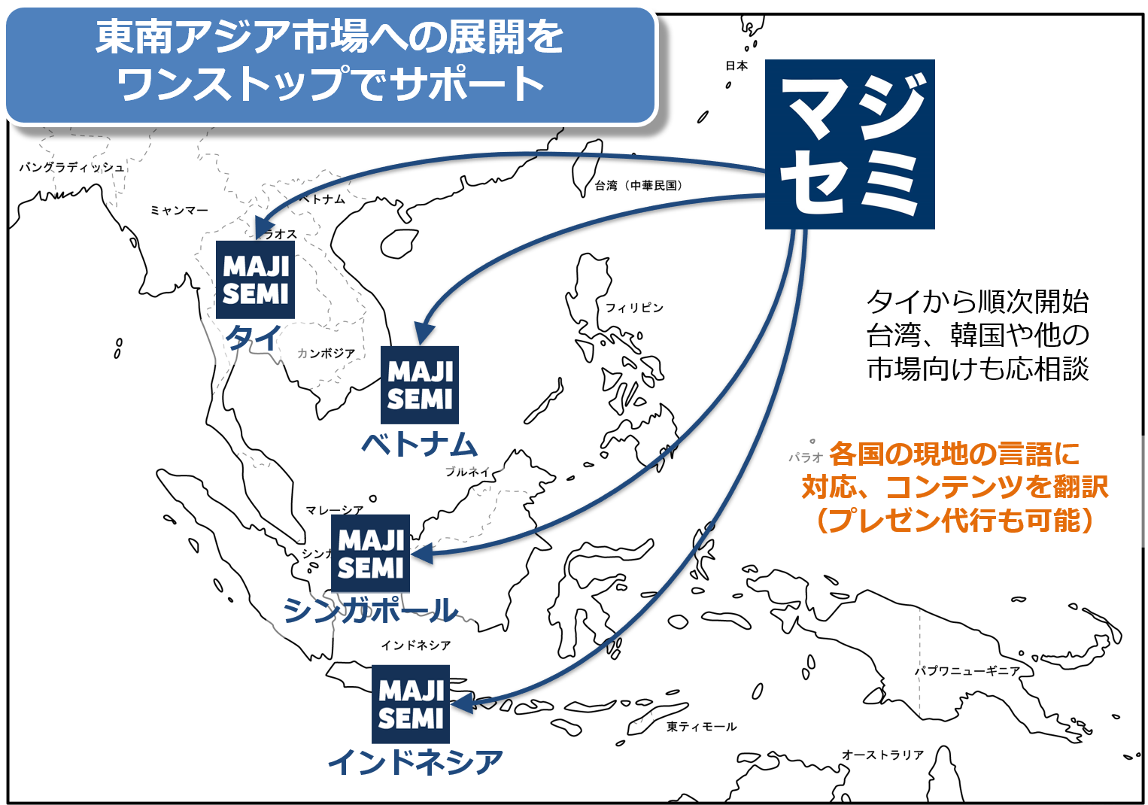
Support for Expanding into Southeast Asia Using Webinars
planning
Webinars can be delivered to Southeast Asia at almost the same price as for Japan.
Your company only needs to prepare a presentation video (+slides) in Japanese (or English).
Majisemi handles everything from adding local language subtitles, translating slides, to the day of delivery.
Options include post-webinar lead follow-up and secondary use of webinar videos with local language support.
Promoting joint exhibition at trade shows held in Southeast Asia.
©2018 MAJISEMI Inc.

Slide 11


Why "Webinar-Based"?
planning
Cold calls or direct mail from no prior contact can lead to distrust.
First, by holding webinars that "provide valuable information," you can establish the initial contact and
gain "trust and credibility."
Features of Webinars
When emailing the entire list
Can provide an "interactive experience"
Live Q&A
Demonstrations and factory tours while receiving questions and requests
Can obtain "live feedback"
Pre/post surveys, as well as polls and questions during the lecture
Can attract viewers with "high interest"
In small webinars, people struggling with issues your products/services can solve participate
Build trust by "sharing the space"
Recognized as a "teacher"
Building trust through communication such as Q&A
0.7%
70%
Response rate when sending materials via email
is about 100 times!
When emailing seminar participants
Face-to-face communication with customers
can enhance trust and credibility
Response to subsequent follow-up
is approximately 100 times different
※ According to our research
©2018 MAJISEMI Inc.

Slide 12
Overview of Majisemi Services
©2018 MAJISEMI Inc.

Slide 13
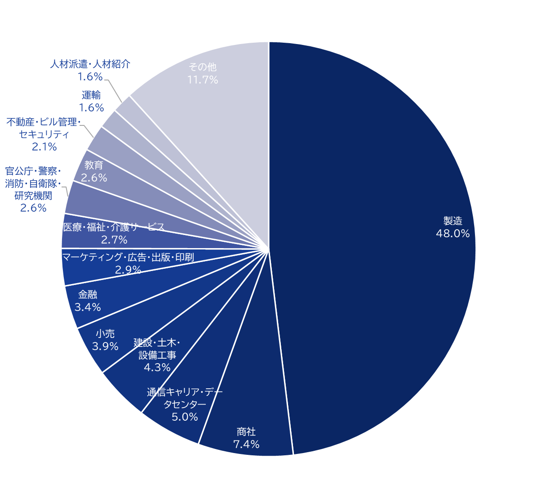
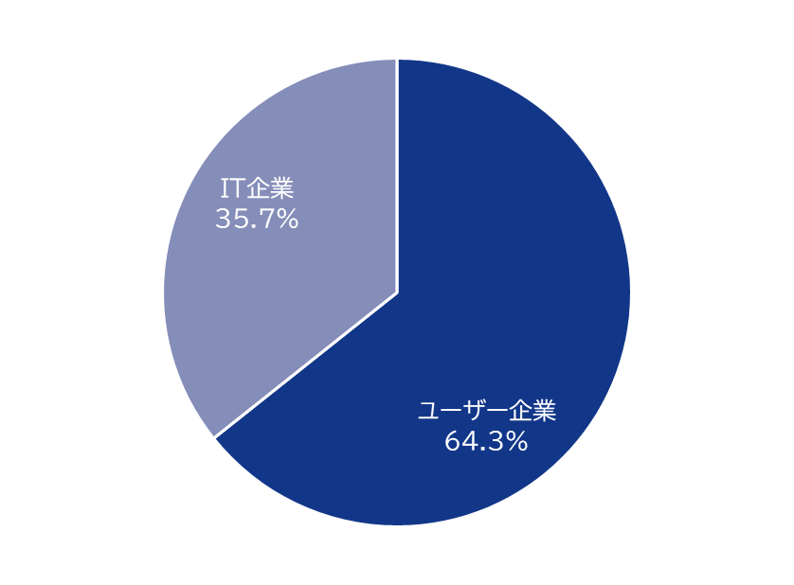
Majisemi's House List
Webinar
as a Service
Attracting Power
Approximately 250,000
Own a house list!
Breakdown of User Companies
House
List
Overall
※Estimated from seminar applicants from 2020 to 2024
©2018 MAJISEMI Inc.

Slide 14
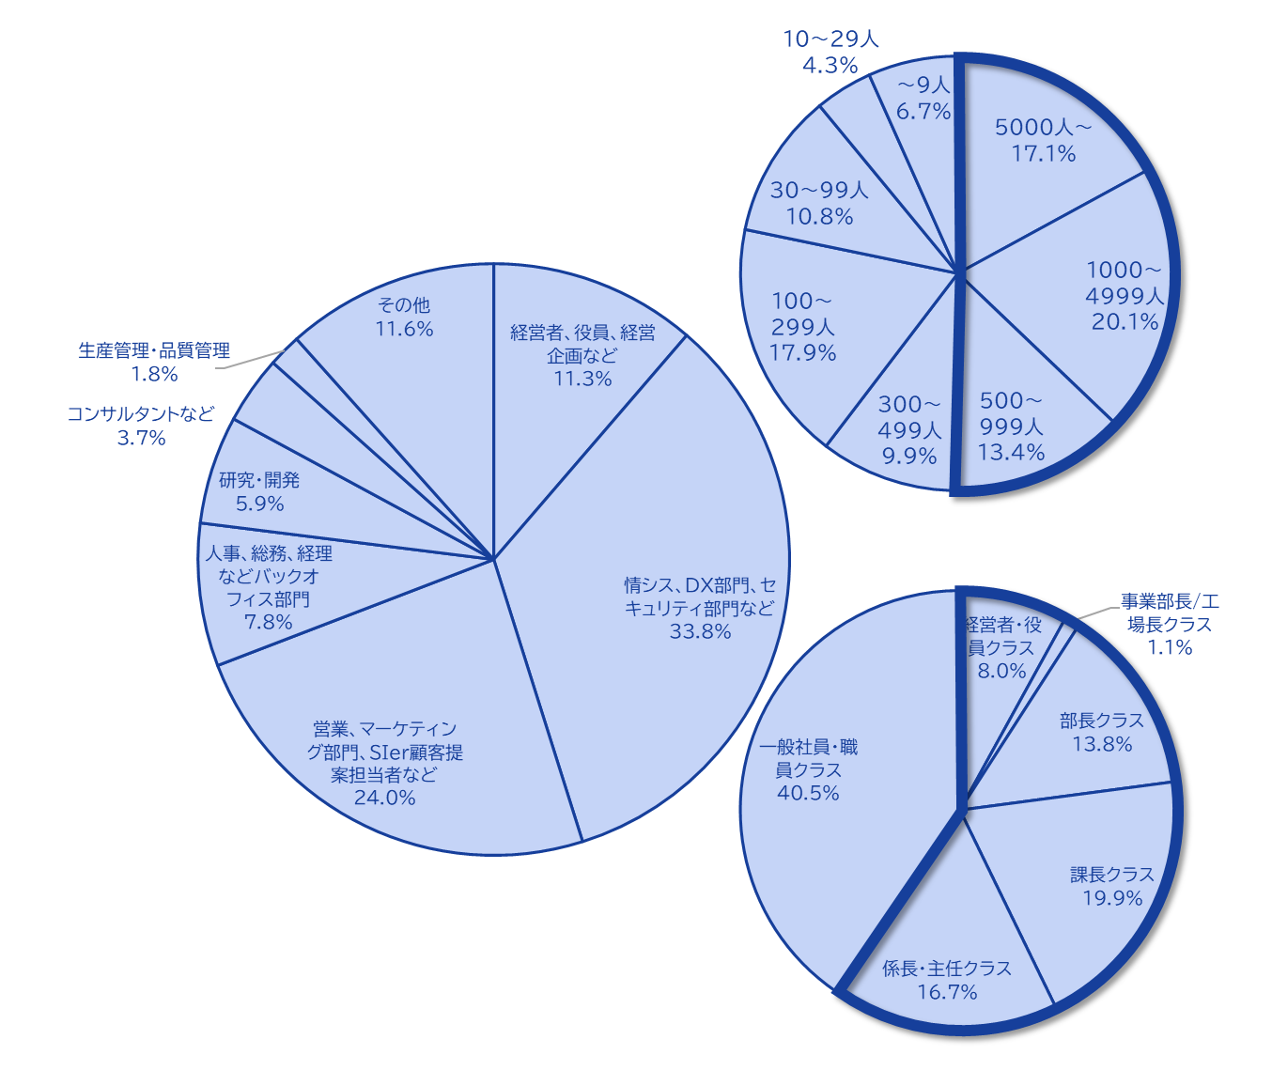
Majisemi's House List
Webinar
as a Service
The Majisemi list
is almost exclusively focused on the following attributes.
Nearly half work at
large enterprises
Company
Size
All industries × Information systems department, DX-related department
All industries × Security department
Manufacturing × Production and manufacturing department
All industries × Back office department
IT companies × All job functions
Job function
Breakdown of house list
At Majisemi, to ensure that participants in the webinar are better matched to your products and services, instead of using attribute specification (segmentation) when attracting attendees via email,
we design the webinar theme (title, announcement text)
on behalf of Majisemi,
adopting a method that increases the proportion of your target audience.
Emails are not sent to all contacts but prioritized for those with high interest in the set theme.
Position
Primarily managers
©2018 MAJISEMI Inc.

Slide 15





Why is it necessary to host webinars?
Webinar
as a Service
The value of cold leads and the importance of repeating webinars
Lead acquisition
Nurturing and business negotiations
Contract
1 person
Hot leads
3 people
Seminar hosting
30 people
Cold lead
21 people
Repeat hosting
is important!
27 people
Including past participants, repeatedly holding webinars
to streamline new lead acquisition and nurturing.
If left unattended
21 people
80% within 2 years
contract with competitors
Majisemi conducts long-term follow-up with past participants,
and also offers 'Maji Follow Plus' to assist in appointment acquisition.
(SiriusDecision survey)
©2018 MAJISEMI Inc.

Slide 16








Reasons to use Majisemi
Webinar
as a Service
Outsource your webinar management
Repeat PDCA to explore winning patterns
Planning
Audience acquisition
Seminar
Secretariat
Moderation
Appointment acquisition
(Optional)
Survey aggregation
Report creation
SEO article creation
Video production
(Optional)
Review &
Improvement
One-stop service
from start to finish
Majisemi handles it all, so
All support included
with only audience acquisition costs!
Focus on the presentation
on the day!
©2018 MAJISEMI Inc.

Slide 17

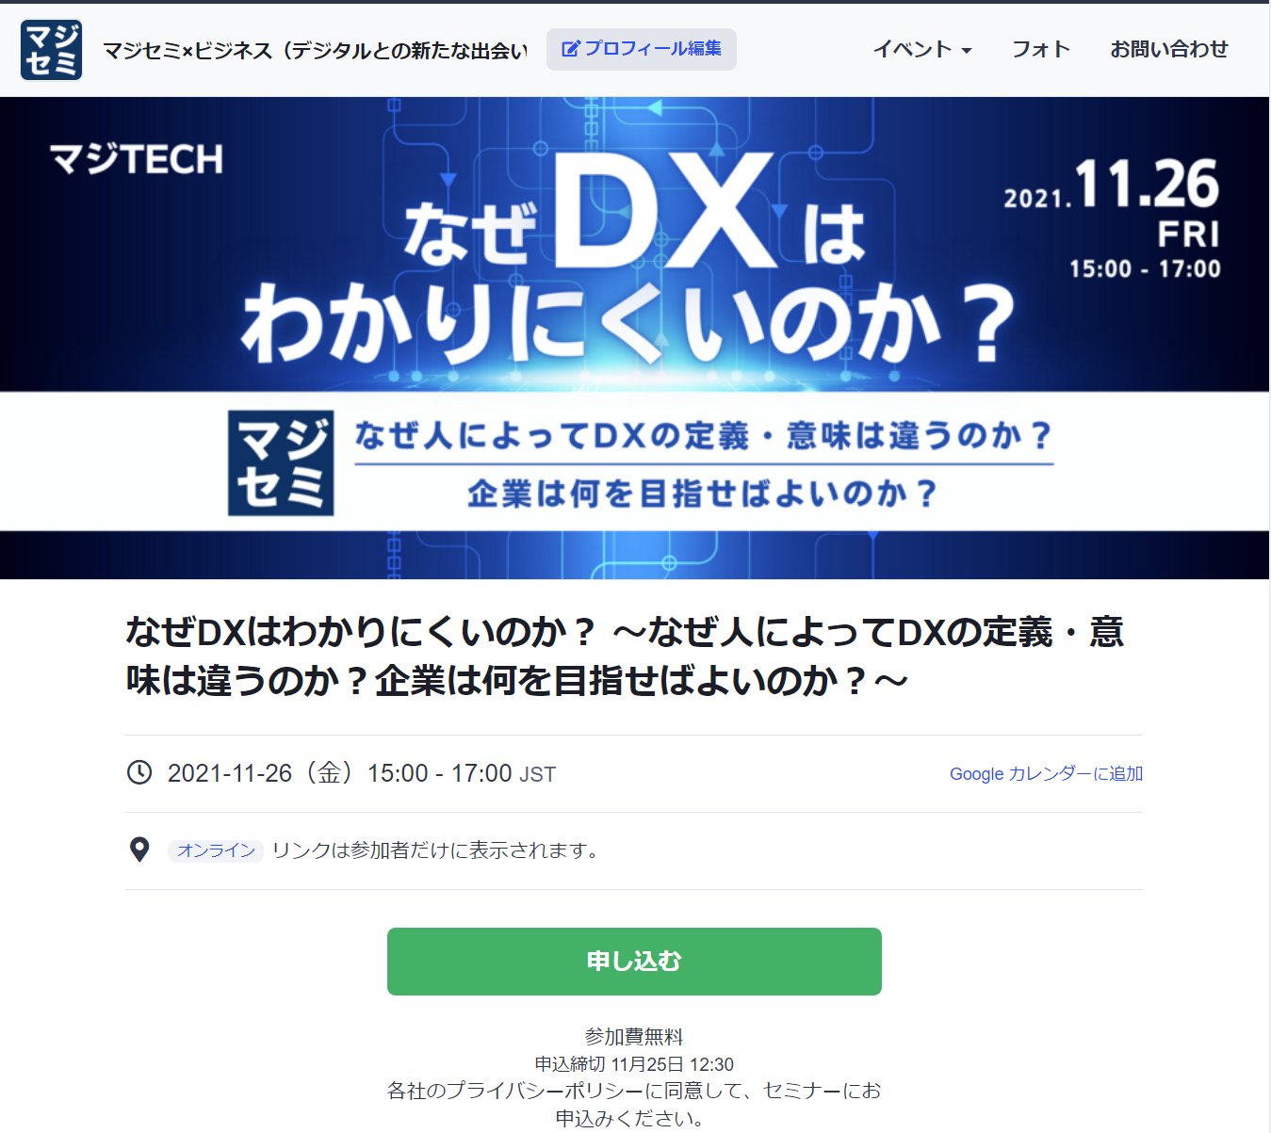
Reasons to use Majisemi
Webinar
as a Service
１回のウェビナーで 新規リード獲得 と、 既存リードのナーチャリング を同時に行うことが可能
Audience acquisition page creation & publication
Audience acquisition
マジセミ管理画面
1週間前＆前日リマインド配信
Majisemi audience acquisition slot
マジセミで集客
マジセミ枠
申込者データ
参加用URL配信
企画FIX
貴社集客枠への
お申し込みは
何名でも課金対象外！
貴社がすでにお持ちの
ハウスリストのナーチャリング、
休眠顧客の掘り起こし、
HP等での新規リード獲得に
ぜひご活用ください！
Your audience acquisition slot
After publication
We will provide
the URL
貴社ハウスリスト・HP等でご集客
Your audience acquisition slot
申込者データ
マジセミ集客枠のミラーサイトで、
貴社専用の集客サイトURLを作成致します。
貴社へ全リード納品
©2018 MAJISEMI Inc.
※お断り対象者・キャンセル待ち申込者は除く

Slide 18
ウェビナー成功事例

Slide 19
（事例１）「テーマを変更し、120名以上の集客を実現」＜C社＞
■お客様の課題
・サーバ／インフラ系サービスを中心に販売されている、SIer様
・自社でウェビナーを開催しているが集客できない
・メディアに集客を依頼しても、集客できなかった
■ご利用いただいたプラン
・ビジター（その後、マジセミ倶楽部へ移行）
■マジセミでの対応
・年間1000回のウェビナー開催の中での集客傾向 ノウハウや、 「トレンド分析ツール」な を活用し 、 「集客できる企画」をマジセミ側で立案、ご提案
■結果
・120名以上の集客実現
©2018 MAJISEMI Inc.

Slide 20
（事例2）「テーマを模索しながら50%以上のアポを獲得」＜T社＞
■お客様の課題
・ツールベンダー様
・展示会等中心のマーケティングを実施していたが、商談化に苦戦
■ご利用いただいたプラン
・ビジター（その後、マジセミ倶楽部へ移行）
■マジセミでの対応
・While repeatedly holding webinars, explore themes that can attra ct a certain level of audience and lead to business discussions.
■結果
・Improve the conversion rate from 10%→20%→50% while attracting around 30 attendees each time.
・Presenters themselves conduct follow-ups after the webinar.
©2018 MAJISEMI Inc.

Slide 21
(Case Study 3) "Switched to online and acquired 20% appointments" <Company Z>
■お客様の課題
・A global IT company developing and selling packaged products and SaaS.
・Struggling with attracting attendees and attendance rates for offline seminars.
・Not leading to business discussions.
■ご利用いただいたプラン
・Visitor
■マジセミでの対応
・Proposal for online (webinar)
・Implemented "seminar planning that leads to business discussions".
■結果
・30 registrations→achieved 6 appointments.
©2018 MAJISEMI Inc.
‹#›

Slide 22
(Case Study 4) "Acquired over 15% appointments with follow-up outsourcing" <Company I>
■お客様の課題
・An infrastructure IT venture company also developing its own products.
・Held several webinars with successful audience attraction, but not leading to business discussions.
・The person in charge is too busy to conduct sufficient sales follow-up after webinars.
■ご利用いただいたプラン
・Visitor
■マジセミでの対応
・Implemented "seminar planning that leads to business discussions".
・Implemented the follow-up outsourcing service "MajiFollow" that makes calls immediately after the webinar ends.
■結果
・50 registrations→achieved 8 appointments.
©2018 MAJISEMI Inc.

Slide 23
(Case Study 5) "AI presented and acquired 20% appointments" <Company A>
■お客様の課題
・Foreign SaaS vendor.
・Achieving audience targets every time but not leading to business discussions.
・Issues with presentation materials and content.
■ご利用いただいたプラン
・Majisemi Club
■マジセミでの対応
・Implemented speech script creation by generative AI and presentation outsourcing by AI digital human.
・Implemented the follow-up outsourcing service "MajiFollow" that makes calls immediately after the webinar ends.
■結果
・20 registrations→achieved 4 appointments.
©2018 MAJISEMI Inc.

Slide 24
About plans and pricing
©2018 MAJISEMI Inc.

Slide 25
Plan comparison
Pricing Plans
Recommended
 | Visitor | Majisemi Club Light | Majisemi Club Business Discussion Guarantee
Recommended for these people! | Planning to hold webinars 1 to 2 times a year | Planning to hold webinars 4 times or more annually Want to reduce cost per lead | Want business discussions (appointments) instead of just attracting attendees Want a guarantee
Cost per lead comparison | 14,500 yen | 12,000 yen (10 people per month) 10,000 yen (for additional audience) | 20,000 yen (30 people over 3 months) 13,500 yen (for additional audience)
Not subject to duplicate charges for past applicants *See each plan description for details | None | Available | Available
Meeting (appointment) guarantee *See each plan description for details | None | None | Available
Contract period | Per session | Monthly (Automatic renewal) | Every 3 months (Automatic renewal)
©2018 MAJISEMI Inc.

Slide 26
Are there any services other than the basic plan that you are interested in?
Service Map
Limited slots
First-come, first-served
Exhibition
Joint exhibition
Your owned leads
(Not subject to charges)
Webinar hosting
Lead follow-up, proposal, and order
Recommended
New service
Lecture script and materials
Creation support
AI-based presentation support
Webinar hosting
(Visitor or Majisemi Club)
Follow-up immediatel y after the webinar
(Maji Follow)
Sales outsourcing
(Proposal and order)
(Maji Sales)
Your insi de sales
or fiel d sales
Recommended
New service
Many companies
Are utilized
Missed
Broadcast
Rebroadcast
2-step
Webinar
Many companies
Are utilized
Utilization of webinar content
Many companies
Are utilized
Many companies
Are utilized
Recommended
New service
SEO article
Creation
Full video
Provided/Free
Full video
Provision/secondary use
Summary
Video production
SEO video creation
©2018 MAJISEMI Inc.

Slide 27
Majisemi Club or Visitor?

Slide 28

Plan comparison
Pricing Plans
Visitor
Seminar hosting 30 attendees achieved
Majisemi Club
Seminar hosting 30 attendees achieved
(Monthly fee)
10 additional people every month
10 people × @12,000 yen
Attendance slots
10 people
Use the 20 free slots benefit
Attendance slots
20 people
Billing
30 people × 14,500 yen = 435,000 yen (excluding tax)
Billing
10 people × 12,000 yen = 120,000 yen (excluding tax)

Slide 29
Majisemi Club Initial 20 Free Slots Benefit
Campaign
By contracting Majisemi Club, you can use this benefit at the time of your first event.
You can cancel at any time. Even if you cancel after one session, it is more advantageous than being a visitor.
特典を利用した開催のイメージ
 | January | February | March | April
Membership fee billing amount | 120,000 yen | 120,000 yen | 120,000 yen | 120,000 yen
Additional attendance slots | +10 people | +10 people | +10 people | +10 people
Campaign-based Additional attendance slots (free) | +20 people | - | - | -
Remaining attendance slots | 30 people | 10 people | 20 people | 30 people
Seminar hosting | 30 people | - | - | 30 people
いつでも集客枠を追加購入
（@1万円でお得）することで、
追加でウェビナーを開催可能
初回20名分無料
すぐに30名定員の
ウェビナー開催可能
初回のみの開催で、3月末の解約（申告は2月末）の場合、
会費12万円×3ヶ月分のみご請求。
©2018 MAJISEMI Inc.

Slide 30
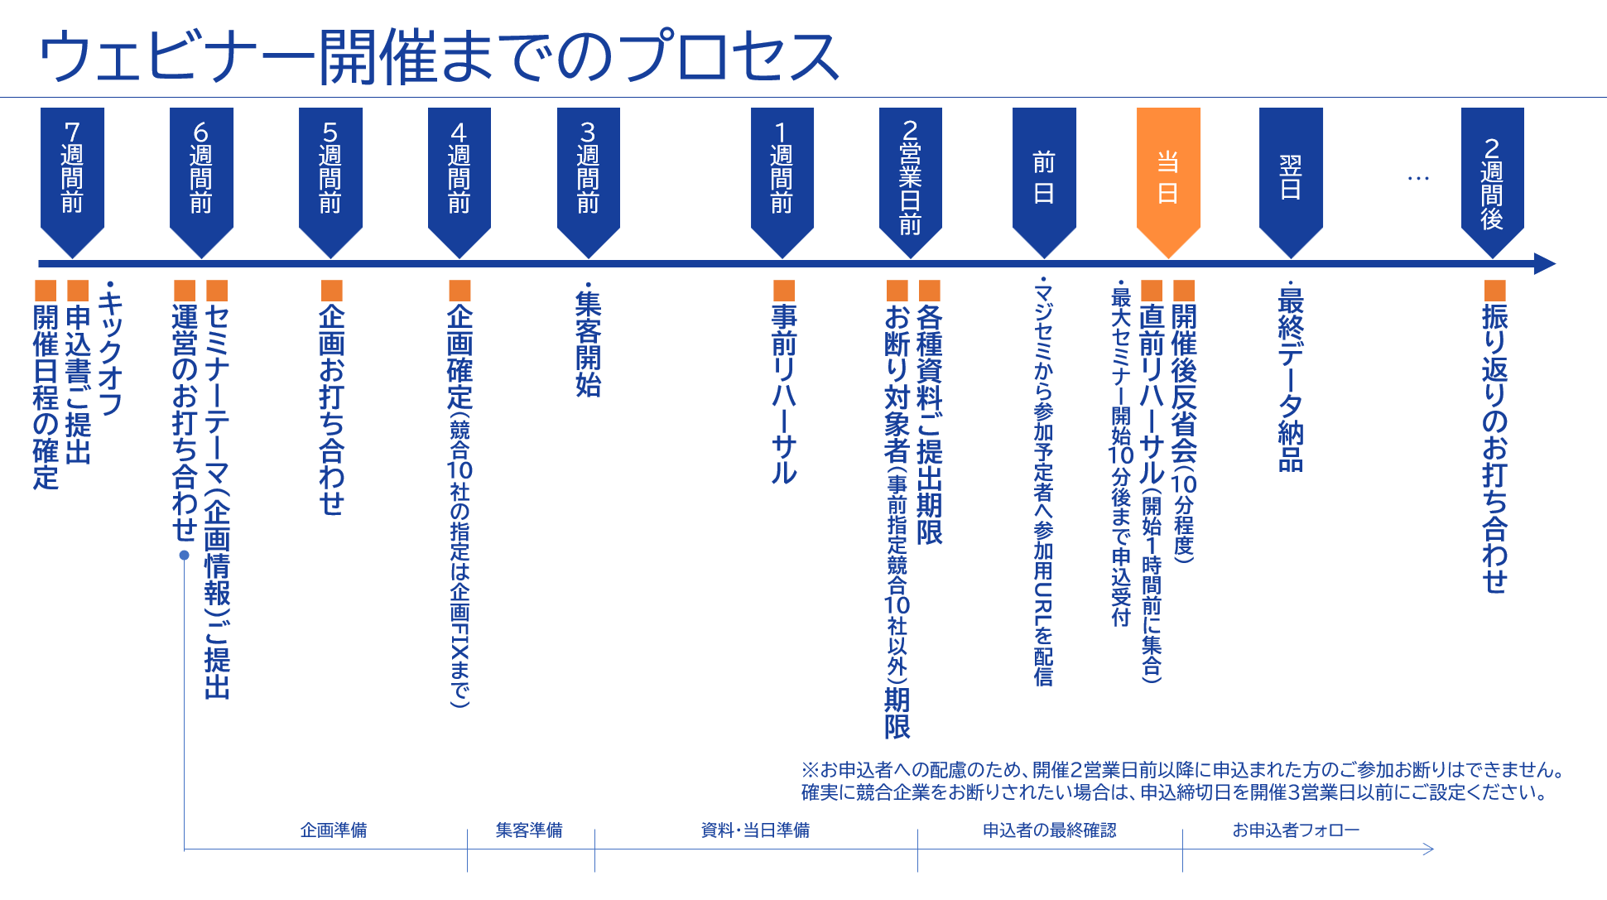
©2018 MAJISEMI Inc.

Slide 31
この機会に、マジセミをスタートしましょう！
マジセミをご利用いただいているクライアント企業様からは
集客もいいし、
商談に繋がっています
認知度が上がり、Webからの
問い合わせも増えました
スタッフ（アテンダント・キャスト）の対応が素晴らしく、
セミナー開催が“楽”になりました
といった声をいただいています。
そしてほとんどのクライアント企業様が、繰り返しマジセミでセミナーを開催しています。
しかし、以下の不安があると思います。
「本当にターゲット企業が来るのだろうか？」
「どのくらいオペレーションが楽になるのだろうか？」
そのようなお客様向けに
「マジセミ倶楽部加入時初回20名無料」キャンペーンをご用意しています。
ぜひマジセミをお試し下さい！
©2018 MAJISEMI Inc.

Slide 32
～後ほどご確認ください～
（ご参考）その他の情報

Slide 33


Reasons to use Majisemi
Webinar
as a Service
Outsource your webinar management
専任の企画担当が、タイトル・告知文を作成します！
Planning
IT知識を有したマジセミの企画専任担当者が、集客と商談化を実現するウェビナー企画を一緒に作り上げていきます。
STEP1
STEP2
STEP3
本申込
商材名・商材情報・ターゲット・ペインポイントを管理システムにご入力いただきます。
Planning meeting
We will hold a one-hour meeting online.
We will align details based on preliminary information.
企画FIX
Please press the approval button in the management system to finalize the plan.
弊社にて
Preparation for the launch of the
promotion page has
started!!
メールで
ご確認
アテンダント（セミナー事務局）がウェビナー開催までサポートします！
アテンダント
（セミナー事務局）
年間1000回のセミナー運営経験のあるアテンダントが、セミナー開催まで一緒に伴走致します。
お困りごとは気軽にご相談いただけます！
STEP4
STEP 5
STEP6
On the day
・Moderation
・Collecting surveys
Promotion page launch
Creation of application page
Handling of applicants
・Responding to inq uiries ・Reminders
・Issuing participation URLs
Rehearsal
・Confirming the flow and requests for the day ・Checking the speaker's connection e nvironment ・Confirming preparation status
Report creation
Cast
Cast
©2018 MAJISEMI Inc.

Slide 34
Reasons to use Majisemi
Webinar
as a Service
Dedicated support from the planning stage
Flow of the planning stage
Preliminary preparation
The planning manager will gather information on the seminar theme you share in advance and create promotional angle proposals.
Planning meeting
We will hold a meeting for about one hour. We will propose promotional angles and align details.
Creation of the plan
Based on the content aligned in the meeting, the planning manager will create drafts of the title and announcement text.
Submission of the plan
After creating the plan, the planning manager will submit it via email.
Confirmation of the plan content
Please review the content of the plan and share any feedback you may have.
Finalization of the plan
Once the content review and feedback revisions are complete, please press the approval button in the management system to finalize the plan.
Preparation for the launch of the
Start of preparation for launch
©2018 MAJISEMI Inc.

Slide 35
Event flow
On the day of the event
Webinar
as a Service
Event time
Distribution tools
Typical seminar flow
You can choose from 5 slots
(Weekdays only *No events on weekends and holidays)
The basic duration for one seminar is 1 hour
You can choose from 2 types
*We recommend Zoom for its functionality and delivery quality
*For seminars hosted by Majisemi, an additional fee is charged for events longer than 1 hour (150,000 yen/hour)
10:00～11:00
Registration starts
15 minutes
11:00～12:00
Opening
(Majisemi Cast)
Zoom
Teams
13:00～14:00
5 minutes
Lecture
14:00～15:00
30-40 minutes
Poll
15:00-16:00
Q&A
(Navigated by Majisemi Cast)
*On Mondays, only the 14:00 and 15:00 sessions are available
*Majifolo is conducted only at the 10:00 and 11:00 sessions
*For seminars targeting the manufacturing industry, to avoid theme overlap, sessions are held at 11:00 and 13:00
10-15 minutes
End
©2018 MAJISEMI Inc.

Slide 36
Reasons to use Majisemi
Webinar
as a Service
コンテンツの有効活用
ブランディング・新規リード獲得
講演内容から記事を作成
自社サイトに登録、SEO対策にも
SEO article
(ブログ)作成
ウェビナー開催時の
コンテンツを再利用して、
開催後も継続して リードナーチャリン グ 新規リード獲得
Distributed later exclusively to absentees
Rebroadcast past Majisemi event videos
Effortless event with no live presentation
ウェビナ ー 開催
Missed broadcast
Rebroadcast
Recorded video
Upload to your own website or YouTube
Summary vid eo creation
On your own website or
Posted on your own managed SNS
Webinars or videos other than Majisemi
Secondary use on portals and advertising media
Full vide o provided/free*
Full video p rovided/secondary use*
リードナーチャリング
Posted on majisemi.com
新規リードを獲得
マジセミ倶楽部特典
※トライアルでは無料・有料を問わずフル動画の提供を行っておりません 。 ただし、本契約後はプランを問わず過去のご開催分を提供可能です。
Majilead
Document download
©2018 MAJISEMI Inc.

Slide 37
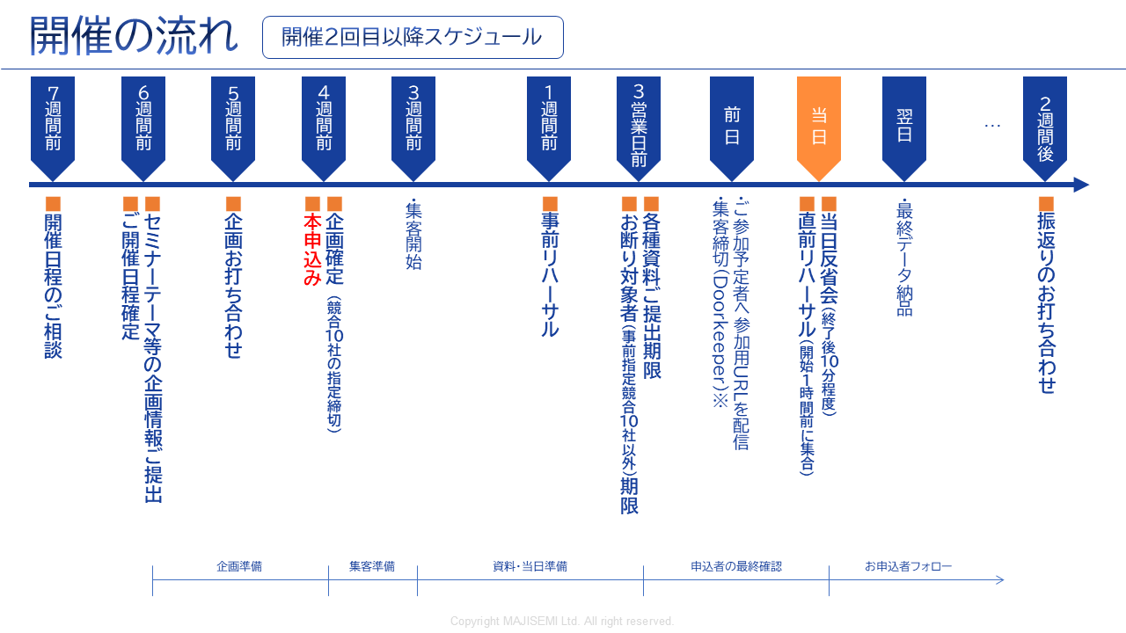
Webinar
as a Service
※お申込者への配慮のため、開催2営業前以降に申込まれた方のご参加お断りはお受けできません。
確実に競合企業をお断りしたい等の場合には、申込締切日を3営業日前にご設定ください。
©2018-2024 MAJISEMI Inc.
©2018 MAJISEMI Inc.

Slide 38
基本プラン
マジセミビジター
Plan Details
Reference Plan
Pricing Plans
単発でウェビナーを開催いただける完全成果報酬型のプランです。
どこまでお任せいただくか4つのタイプからお選びいただけます。
20名からのお申し込みで承ります。
申込が10人しかなかった場合は、10人分のみのご請求となります。
1人申込あたり14,500円(税別)
・ 都度開催、都度申込
・ 集客数による成果報酬型課金
・ 20人以上からの申込
（請求は集客人数分のみ）
※集客人数を正確に把握するため、弊社にてお申込みページを準備し、リストを貴社にご提供いたします。
※実際のご請求は、申込者数に対して上記最大人数までの成果報酬でご請求させていただきます。定員に達した場合、申込受付をストップ致します。
※リストの納品は個人情報保護の観点から、セミナー主催者様に直接納品させていただきます。
※セミナーの参加者だけではなく、欠席者（事前キャンセル、当日キャンセル）についても、ご請求対象となります。
※なるべく上限近く集客できるよう努力いたしますが、集客数を保証するものではありません。
※セミナーのテーマや同時開催の他のイベントなどの影響により、全く集客できないケースもございます。
Management
Management
Menu |  | Planning | Audience acquisition LP Installation | Moderator | Other Media Incorporation | URL Delivery Reminder | Zoom Provision | Post-event Survey
Majisemi Visitor | Standard | ○ | ○ | ○ | No Other Media Posting Allowed | ○ | ○ | ○
 | Planning & Customer Acquisition | ○ | ○ | － |  | － | － | －
 | Customer Acquisition & Management | － | ○ | ○ | － | ○ | ○ | ○
 | Customer Acquisition Only | － | ○ | － | － | － | － | －
商品名 | 内容 | 数量 | 単価（￥） | 金額（￥）
マジセミビジター （20名）） | ウェビナーの 企画・集客・運営 | 20 | 14,500 | 290,000
Visitor Plan Reference Plan for 20 People |  | Subtotal |  | 290,000
 |  | Consumption Tax (10%) |  | 29,000
 |  | Total (Including Tax) |  | 319,000
©2018 MAJISEMI Inc.

Slide 39
基本プラン
Majisemi Club Light
Plan Details
Reference Plan
Pricing Plans
Monthly Fee: 120,000 yen (excluding tax) *Includes 10 customer acquisition slots for the Light Plan
Additional Customer Acquisition Slot @10,000 yen (excluding tax)
Automatic renewal every month
10 customer acquisition slots added each month
Minimum webinar capacity is 30 people
If you hold a webinar with 30 participants in the first month, purchase an additional 20 participant slots (@10,000 yen each)
If the number of participants does not meet the quota, the remaining slots can be carried over to the following months
Additional participant slots can be purchased for @10,000 yen
If someone who has registered for your company's past three seminars (subject to charges) registers again for the current seminar, the current seminar will not be subject to charges (fan development)
Other benefits include providing leads from those who download publicly available presentation materials, offering a branding dashboard, and providing trend analysis tools
Majisemi Club is a membership service that improves webinars by running the PDCA cycle through repeated webinars. Admission is subject to review.
For Majisemi Club, we provide a one-stop service including planning, customer acquisition, moderation, and management. We cannot support customer acquisition only.
Furthermore, the seminar content (planning) will be a "problem-solving seminar" rather than a "product introduction." Product introductions will be conducted in the latter half of the presentation. The seminar content will be decided in consultation with Majisemi's planning members. It may not be possible to hold the seminar on the theme your company desires. If you wish to decide the theme yourself, please use the Visitor plan.
Please note that considering the purpose of the aforementioned Majisemi Club, a penalty will be set for cancellations within one year of the contract start. (The difference from the Visitor fee will be charged.)
※集客人数を正確に把握するため、弊社にてお申込みページを準備し、リストを貴社にご提供いたします。
※ If the capacity is reached, we will stop accepting applications.
※リストの納品は個人情報保護の観点から、セミナー主催者様に直接納品させていただきます。
※ Not only participants but also absentees (cancellations before and on the day) are counted towards the number of attendees.
※ The contract is automatically renewed monthly and will continue in the same manner.
※ Upon withdrawal, refunds for unused customer acquisition slots cannot be made. Additionally, rejoining Majisemi Club is not allowed for one year after withdrawal.
※ Please notify us by email by the end of the month prior to the withdrawal month.
※ Benefits are subject to change.
If you have challenges in converting seminars into business discussions or want to strengthen your website content and SEO, please consider our value set plans mentioned later.
商品名 | 内容 | Category | 金額（￥）
Majisemi Club Light (30 participants) | Planning, attracting participants, and managing webinars | Monthly fee | 120,000
Majisemi Club Light Plan 30 participants attracted, If 10 participants are attracted through the monthly fee and 20 through additional slots |  | Additional participant slots | 200,000
 |  | Consumption Tax (10%) | 32,000
 |  | Total (Including Tax) | 352,000
©2018 MAJISEMI Inc.

Slide 40
基本プラン
Majisemi Club Light
billing pattern
Pricing Plans
Example of webinar hosting and billing with Majisemi Club
add 10 attendees every month
Webinar
Held
Webinar
Held
Webinar
Held
seminars can be held anytime (or not at all)
(target capacity is 30 or more, rebroadcasts require 10 or more)
Webinar
Held
 | January | February | March | April | May | June | July | August | September | October | November
Additional attendance slots | +10 | +10 | +10 | +10 | +10 | +10 | +10 | +10 | +10 | +10 | +10
Beginning of the month Remaining attendance slots | 10 | 10 | 20 | 30 | 15 | 10 | 20 | 30 | 40 | 50 | 10
Monthly fee billing | 120,000 yen | 120,000 yen | 120,000 yen | 120,000 yen | 120,000 yen | 120,000 yen | 120,000 yen | 120,000 yen | 120,000 yen | 120,000 yen | 120,000 yen
Seminar hosting Target capacity | 30 people |  |  | 30 people | 50 participants |  |  |  |  | 50 participants
Seminar hosting Participant achievement | 30 people |  |  | 25 participants | 48 participants |  |  |  |  | 50 participants
consumption of attendee slots | -10 |  |  | -25 | -15 |  |  |  |  | -50
end of the month Remaining attendance slots | 0 | 10 | 20 | 5 | 0 | 10 | 20 | 30 | 40 | 0 | 10
Additional participant slots | 20 |  |  |  | 33
Additional participant slots billing | 200,000 yen |  |  |  | 330,000 yen
target capacity is 30 or more
holding events with 50, 100 participants, etc., is OK
seminars with 30 participants from the first month are OK
carry over any shortfall to the next month
any shortfall will be billed at 10,000 yen per person
there will be no over-attendance beyond the target capacity
©2018 MAJISEMI Inc.

Slide 41

基本プラン
Majisemi Club Business Discussion Guarantee
Plan Details
Reference Plan
Pricing Plans
600,000 yen every three months (excluding tax)
Contract renews automatically every three months
Guarantee of 30 attendees and 3 business meetings every three months
Majifolo is provided for free
If targets are not met, the shortfall will be carried over to future seminars
For additional events with more than 31 participants, 13,500 yen per registration
If someone who has registered for your company's past three seminars (subject to charges) registers again for the current seminar, the current seminar will not be subject to charges (fan development)
Other benefits include providing leads from those who download publicly available presentation materials, offering a branding dashboard, and providing trend analysis tools
This is a plan that automatically renews every three months. We guarantee 30 attendees and 3 business meetings (appointments).
We handle everything from planning the seminar content, attracting attendees, managing the event day, to sending materials to participants.
Majifolo is included in the fee.
If the initial seminar does not meet 30 people or 3 appointments, it will be carried over to that quarter or the next quarter,
We will hold additional seminars. (The goal is to achieve the target in the first attempt)
*To accurately track the number of attendees, we will prepare the registration page and provide the list to your company.
*If the capacity is reached, we will stop accepting applications.
※リストの納品は個人情報保護の観点から、セミナー主催者様に直接納品させていただきます。
※ Not only participants but also absentees (cancellations before and on the day) are counted towards the number of attendees.
*Contracts are automatically renewed every three months and will continue in the same manner.
※ Upon withdrawal, refunds for unused customer acquisition slots cannot be made. Additionally, rejoining Majisemi Club is not allowed for one year after withdrawal.
*To withdraw, please notify us by email by the end of the month prior to the withdrawal month.
*We may not be able to accommodate requests for guaranteed business meetings.
※ Benefits are subject to change.
商品名 | 内容 | 数量 | 単価（￥） | 金額（￥）
Majisemi Club event (30 participants) | Planning, attracting participants, and managing webinars | 1 | 600,000 | 600,000
Majifolo (30 participants) | Appointment setting via phone and email for participants | 30 | 3,500 | 105,000
 | All cases are free under the Majisemi Club business meeting guarantee | 30 | -3,500 | -105,000
Majisemi Club Business Meeting Guarantee Plan Reference plan for 30 participants |  | Subtotal |  | 600,000
 |  | Consumption Tax (10%) |  | 60,000
 |  | Total (Including Tax) |  | 660,000
Guaranteed attendee acquisition and business meetings!
©2018-2023 MAJISEMI Inc.

Slide 42
Majisemi Club's Value Plans (Revision Planned)
Pricing Plans
Recommended
 |  | Light | Silver | Gold | Platinum | Premium
Included Services | Webinar hosting | ● | ● | ● | ● | ●
 | SEO article creation | ― | ●※1 | ― | ― | ●※1
 | Majifollow | ― | ― | ●※2 | ●※2 | ●※2
 | Majifollow Plus | ― | ― | ― | ●※3 | ●※3
 | Summary Video | ― | ― | ― | ― | ●※1
Additional Audience Slot Gift (Bonus) ※4 |  | ― | Every year for 10 people Equivalent to 100,000 yen | Every year for 20 people Equivalent to 200,000 yen | Every year for 40 people Equivalent to 400,000 yen | Every year for 80 people Equivalent to 800,000 yen
Monthly fee |  | 120,000 yen | 135,000 yen | 155,000 yen | 255,000 yen | 385,000 yen
Simply a Webinar
Only want to request hosting
Want to utilize presentation content
on the website
Want to follow up immediately
after the webinar
Want to reliably connect
webinars to business negotiations
Want to maximize
the effectiveness of webinars
※1 SEO article creation and summary video creation can be conducted up to 4 times a year. Additionally, it is possible to conduct more by purchasing as a separate option.
※2 Majifollow can be conducted for up to 120 people per year. Additionally, it is possible to conduct more by purchasing as a separate option.
※3 The monthly activity cost of Majifollow Plus is included. A success fee of 30,000 yen per appointment is charged separately.
※4 The additional audience slot gift bonus is granted one year after joining the Majisemi Club and is granted every year in the same month thereafter.
(All amounts are excluding tax)
©2018 MAJISEMI Inc.

Slide 43
Other options ※Please consult with us for details
Webinar
as a Service
Name | Price (excluding tax) | 内容
Majifollow (Post-seminar follow-up) | @3,500 yen × number of attendees | Majisemi's follow-up specialists will follow up with participants and absentees via email and phone immediately after the seminar ends.
SEO article creation | 50,000 yen | We will create an article of approximately 3,000 characters with SEO in mind based on the seminar content. By publishing it on your website, you can promote content marketing.
Full video provision/paid | 200,000 yen | This is an option to provide you with the seminar video for secondary use. ※We offer it for free within certain usage limits. During the trial, neither paid nor free provision is available.
Summary video creation | 50,000 yen | When posting seminar videos on YouTube, etc., long videos tend to be disliked. Therefore, we will edit and provide a 5-10 minute version.
Missed broadcast | 50,000 yen | For those who registered for the seminar but were absent on the day, we will allow them to view the day's video.
Rebroadcast | @14,500 yen/10,000 yen | Using recordings from past Majisemi events, we will host additional webinars without hassle.
Two-step webinar | 200,000 yen | For those who have previously registered for your webinars (your prospective customers), we will plan and host themes that lead to more business discussions (appointments), such as competitor comparisons, product introductions, demos, etc.
Operational support (operation outsourcing) | 200,000 yen | We will manage your seminar operations on your behalf. This includes creating the registration page, managing registrants, lending Zoom, and moderating on the day. (Attracting attendees is not included. You will need to handle that.)
Presentation by Majisemi representative Terada Presentation at your seminar | 300,000 yen～ ※Approximately 30 minutes to 1 hour | Majisemi representative Terada will facilitate presentations, discussions, or panel discussions at your seminar. Please consult us about the theme.
Keynote speech by 'Evangelist AI' Digital Terada | 100,000 yen | 'Evangelist AI' Digital Terada, utilizing generative AI, will deliver a keynote speech at your webinar. ・You will speak at the seminar but don't have time to create the script or slides ・There are no skilled presenters among your employees (or they are too busy), so you want us to handle the presentation as well
SEO video creation | 50,000 yen per video～ ※In units of 10 videos, excluding initial costs | This is a strategy to aim for top rankings in YouTube and Google video searches. Majisemi will create a custom AI avatar for your company and produce video content explaining terms. Scripts will also be delivered, and blog utilization is possible.
Product comparison video creation | 500,000 yen～ ※Excluding initial costs | We will create competitive product comparison videos to strongly recognize the strengths of your products. Majisemi will create a custom AI avatar for your company and produce product comparison video content. Distribution via webinar is also possible.
©2018 MAJISEMI Inc.

Slide 44
Notes
Webinar
as a Service
■ Generally, meetings start 6 weeks in advance, and the formal application is made 4 weeks before the event.
Additional charges
Cancellation fees
For all services, if you cancel after making a "formal application" through Majikan (Majisemi management screen) or after receiving the order form/application form, a 100% cancellation fee will apply.
However, for webinars, the cancellation fee is capped at 20 visitors for visitors and 30 slots for Majisemi Club.
For Majifolo, the cancellation fee is capped at 20 visitors for visitors and 30 slots for Majisemi Club.
If adjustments to the title, announcement text, etc., are delayed and the webinar cannot be published by 5 PM, 10 business days before the event, it will be treated as a cancellation and the above cancellation fee will be charged.
No refunds will be given for remaining slots upon withdrawal from Majisemi Club.
Considering the purpose of Majisemi Club, a penalty is set for cancellations within one year of the contract start. Please understand. (The difference from the visitor fee will be charged)
マジセミビジター
Orders placed after 4 weeks before the event will incur a surcharge.
 | Unit price (excluding tax) | Upper limit specification
Base fee (Order placed more than 4 weeks before the event) | 14,500 yen | 20 or more
Order placed after 4 weeks before the event | ×1.25 times surcharge
Order placed after 3 weeks before the event | ×2 times surcharge
Various Majisemi Club
If the formal application cannot be made 4 weeks before the event, there is no surcharge, but the event will be postponed upon consultation.
©2018 MAJISEMI Inc.

Slide 45
Majisemi Inc.

Slide 46

Company Name
Headquarters Location
Representative Name
Business Description
Seminar Hosting Record
Established
Capital
Number of Employees
Majisemi Inc.
3rd Floor, Shiodome Building, 1-2-20 Kaiga n, Minato-ku, Tokyo 105-0022 Yuichi Terada
Operation of IT and manufacturing industry-specific seminar marketing service "Majisemi"
Last year's record: approximately 1,000 events held, total attendance approximately 60,000 people (2023)
January 2018
10 million yen
45 employees
About Us
Company Overview
Creating new encounters and experiences with digital-rel ated products and services to promote the development of domestic industries and the advancement of engineers.
To achieve this, we convey the excellence and potential of technology widely to society, regardless of the size of the providing company.
We clearly communicate to end-users not the technology itself, but how it can solve their problems.
By 2025, we aim to host 2,000 webinars annually.
MISSION
Transform seminars into entertainment
Change society through seminars
Thanks to you, we achieved three No.1
achieved! 1
No.1 in seminars strong in attracting customers
Seminars chosen by
IT managers
No.1
For acquiring new business negotiations
Seminars strong in
No.1
©2018 MAJISEMI Inc.
Survey overview by Japan Marketing Research Organization: 2021 service comparison impression survey

Slide 47
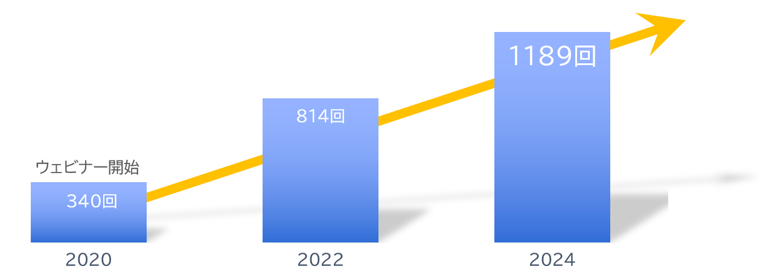
About Us
With Clients
Number of Seminars Held
Increasing Every Year!
A10 Networks, Inc.
ITec Hankyu Hanshin Co., Ltd.
Advantech Co., Ltd.
AXIO Corporation
Assist Corporation
ITOCHU Techno-Solutions Corporation
Internet Initiative Japan Inc.
Infocom Corporation
Equinix Japan K.K.
SCSK Corporation
F-Secure Corporation
MOTEX Inc.
Encourage Technologies Co., Ltd.
Entrust Japan Co., Ltd.
OGIS-RI Co., Ltd.
OPRO Co., Ltd.
QlikTech Japan K.K.
Cross Head Co., Ltd.
KCCS Mobile Engineering Co., Ltd.
Serverworks Co., Ltd.
Sios Technology, Inc.
Cybertrust Japan Co., Ltd.
ZEAL Corporation
CTC System Management Corporation
Systena Corporation
Singapore Telecommunications Japan Co., Ltd.
GMO GlobalSign K.K.
JB Service Co., Ltd.
Startia Raise, Inc.
Smart Style Co., Ltd.
Sumitomo Electric Information Systems Co., Ltd.
Zoho Japan Corporation
Soliton Systems K.K.
Dynatrace
TIS Inc.
Techvan Co., Ltd.
Techmatrix Corporation
Delivery Consulting Inc.
Dell EMC
NSW Inc.
Hulinks Inc.
Netskope Japan Co., Ltd.
Pasona Tech, Inc.
Nippon Telegraph and Telephone East Corporation
Fujitsu Limited
Fujitsu Communication Services Limited
Fuji Electric IT Solutions Co., Ltd.
Mitsubishi Electric Information Systems Corporation
Mirantis Japan, Inc.
Monstar Lab, Inc.
Red Team Technologies, Inc.
Rosetta Corporation
(Agency)
MM Research Institute Ltd.
Creative Bank Inc.
Target Media Co., Ltd.
Nikkei Advertising Inc.
Bigbeat Inc.
Mynavi Corporation
Transaction record
Major Clients Only, In Alphabetical Order
©2018 MAJISEMI Inc.

Slide 48
No.1 in seminars strong in attracting customers
No.1 Seminar for Acquiring New Business Deals
No.1 Seminar Chosen by IT Managers
Survey by Japan Marketing Research Organization Overview: 2021 Service Comparison Impression Survey
Transform seminars into entertainment
Change society through seminars

